Slide 1
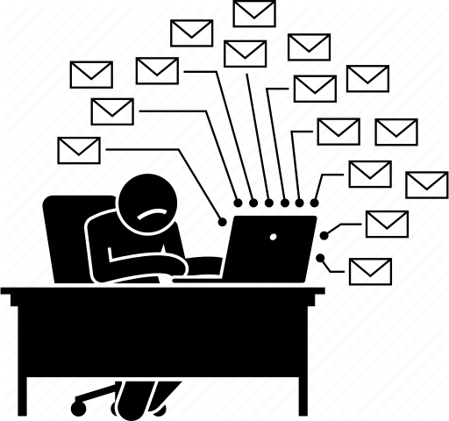
De Escalating Angry Customers

Slide 2
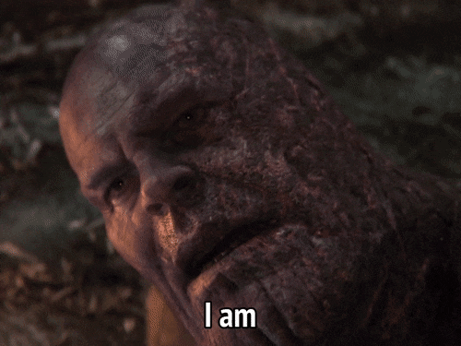
Angry customers on this industry are sort of like this….

Slide 3
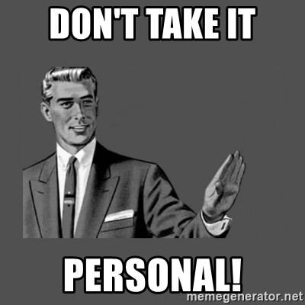
So, what do you do when you get an angry customer?
Step 1 - DON’T TAKE IT PERSONALLY

Slide 4
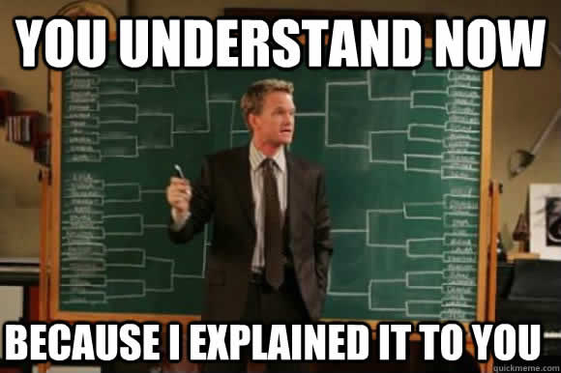
Some Types of Angry Customers
Step 2- Listen to the customer and identify the type of angry customer he/she is
The Talker
These customers aren’t sure what they want, but they think they do. They don’t know what a resolution to their problem looks like. They just want to be heard, so don’t zone them out. Practice your active listening skills. Once they’ve had their say, make sure you restate their concerns. This can help guide them to what they want from you.

Slide 5
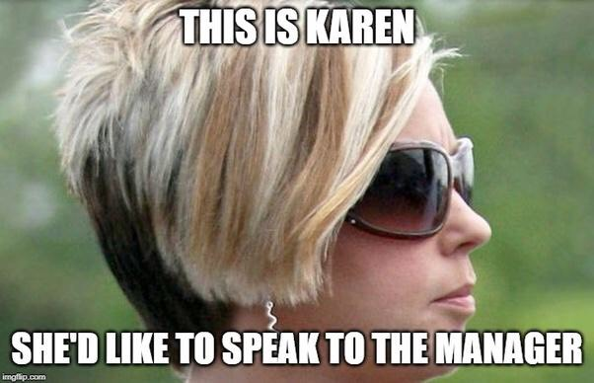
Some Types of Angry Customers
Step 2- Listen to the customer and identify the type of angry customer he/she is
The Executive.
These customers don’t care what it takes, they just want results! They expect you to know who they are, what their problem is, and how you can fix it for them. Getting information out of them may feel like pulling teeth, and they may resent questions. Be patient, explain what you’re doing and why you need the information you’re requesting.

Slide 6
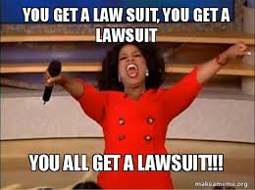
Some Types of Angry Customers
Step 2- Listen to the customer and identify the type of angry customer he/she is
The Intimidator.
hese customers love the phrase “...or else!” It gets old, and can even sound silly, but try not to take it personally. Like The Venter, let them have their say. Repeat their concern back to them and allow them correct you if you misunderstood something. Proceed to drive the conversation towards a resolution.

Slide 7
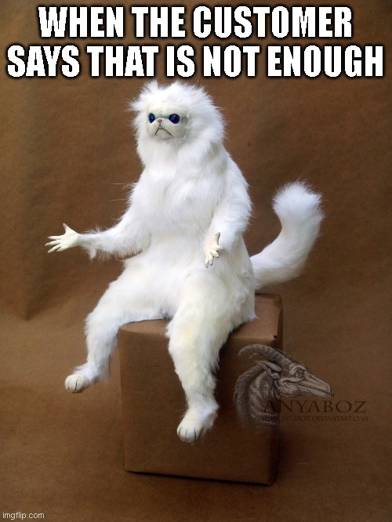
Some Types of Angry Customers
Step 2- Listen to the customer and identify the type of angry customer he/she is
The Sufferer.
No matter what you offer to do, it likely won’t be good enough for this customer. In their eyes, things will never be the same again, and it's all your fault! In this case, there may be no easy resolution the customer will accept. You’ll simply have to tell him or her, “I’m sorry, but that’s the best I can do. Thank you for understanding.”

Slide 8
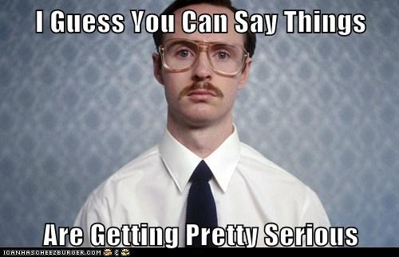
Disclaimer
We are making some fun of this type of customers but beware THEIR problems MATTER and they are important. It does not matter how angry they are, they are customers and they have all the right to vent out. They deserve all your empathy, readiness and willingness to help.

Slide 9
Step 1 - Apologize and Acknowlegde
While this doesn’t solve the person’s issue it makes them feel understood when you acknowledge that they have the right to feel angry.
Step 3- Follow the ASAP De Escalating Process
Step 2- Show Empathy
It is not always easy to put yourselve on the other person’s shoes but it is always necessary. Imagine that you are on their situation, how would you feel?
Step 3- Accept Responsibility
This doesn't translate to taking the blame for the mistake. It means that you need to take ownership and let the member know that you know what you are doing. Even if you are not.
Step 4 - Prepare to help
Now, with a less angry and anxious customer. Prepare to help and provide resolution for their issue. Remember that at the end… they are only humans, trying to solve problems.

Slide 10
Extra tips
Prepare in advance.
Practice responding to different concerns. It might help having scripts, but be careful.
Keep emotions out of it.
Listen, listen, and listen some more.
Identify and understand their anger.
Don’t make promises you can’t keep
It’s important you stay calm throughout the conversation. Don’t let the customer bait you into retaliating, and always watch your tone.
don't tune them out – take notes if you need to.
What the customer complains about isn’t always the actual problem. This is where you have the chance to play detective.
Don’t make promises you can’t keep. Never lie to the customer. You may be tempted. Don’t do it!
Notes:
Answers:
1- B
2- B

Slide 11
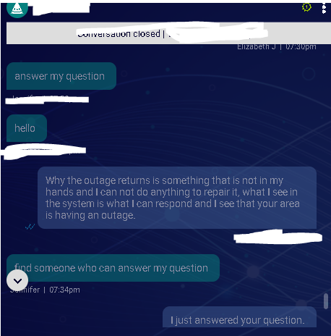
Customer calls in due to lack of internet. The agent advises him/her that there is an outage in his/her area. The customer demands to know WHY there is an outage.
Let’s see the interaction.
What things would you do different?
What would you say?
Did the agent do the proper thing? What thing can you offer in a situation like this?
Real life examples

Slide 12
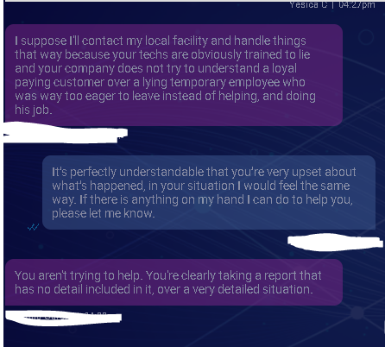
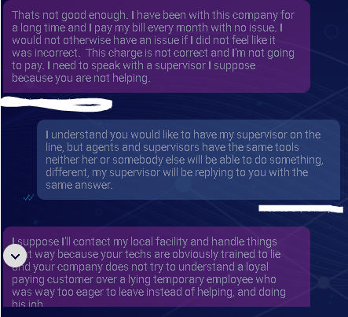
Customer contacts us over a TC appointment that shows as missed but she claims not to have missed it and to have had a similar issue before. Agent says, they cannot waive it because it shows as if the technician showed up and rebooted her modem.
Let’s see the interaction.
What things would you do different?
What would you say?
Did the agent do the proper thing? What thing can you offer in a situation like this?
Real life examples

Slide 13
NO
Calm Down / Settle Down
Avoid using this words… I will give you some alternatives
I can’t do that, but this is what I can do…
I truly understand how you feel.
It’s not my fault
There’s nothing I can do
Let me see how I can fix this.
While I can’t do that, this is what I can do…
I don’t know
Sorry, that’s the policy
Let me find the answer for you /// I will sort this out for you.
This is the policy, however, I can offer this alternative.

Slide 14
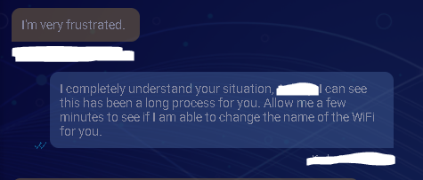
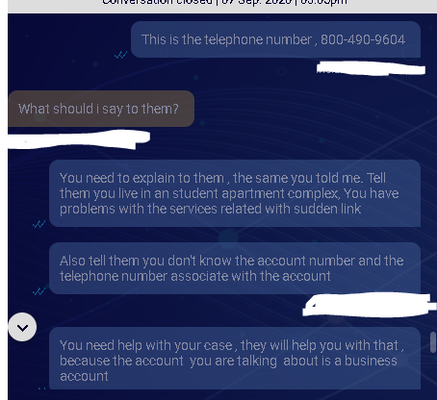
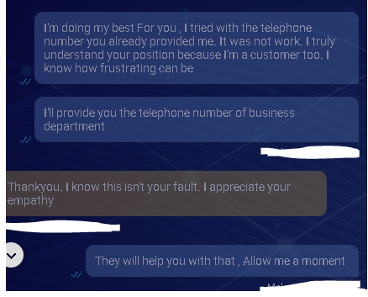
In this case the customer was very frustrated because she had been chatting with another agent who closed the chat. The next agent managed it very well
Some good examples of de escalating
In this case the customer could not be handled through us but he was also feeling frustrated. The agent guided him through instead of just providing a number

